Slide 1
CSCE 3600 Principles of Systems Programming Processes
University of North Texas

Slide 2

Process Management

Slide 3

What is a Process?
A program is a passive set of instructions stored on a secondary storage device, such as a disk
A process is an active execution of a program stored in memory
Program becomes process when loaded into memory
Processes can create sub-processes to execute concurrently
The execution of a process must progress in a sequential fashion
The CPU executes one instruction of the process after another until the process completes, or other event occurs

Slide 4
More Precise Definition
A process is the context (i.e., information and data) maintained for an executing program
A process needs certain resources, including CPU time, memory, files, and I/O devices, to accomplish its task
Intuitively, a process is the abstraction of a physical processor
Exists because it is difficult for the OS to otherwise coordinate many concurrent activities, such as incoming network data, multiple users, etc.

Slide 5
Process Management
The OS is responsible for the following activities
Process creation and deletion
Process suspension and resumption
Provision of mechanisms for:
Process synchronization
Process communication
Deadlock handling
How does OS correctly run multiple processes concurrently?
What kind of information must be kept?
What does OS have to do to run processes correctly?
OS must be able to distinguish among different processes
Multiple programs may be loaded into memory at same time
Each process is assigned a unique, non-negative integral process ID, or PID

Slide 6
Process Identifiers
Special processes with well-known process IDs
swapper / sched
PID 0, as part of the kernel, a system process responsible for memory management
init
PID 1, a continually-running daemon process (i.e., one that runs in the background) responsible for starting up and shutting down the system
Invoked by the kernel at the end of the bootstrap procedure
replaced by systemd in many Linux distributions
Check out the pstree command that prints a tree of the processes

Slide 7
Process Identifiers
When a process is created by running a program, it is allocated some system resources including memory and a proceed ID number (PID).
Every process has a unique ID number (see below e.g. bash)
Each process has a parent process that started it (see below e.g. login) which also has a PID.
A process can spawn other processes called child processes
Parent process Child processes
The pid is used by the kernel to manage and control the process during its lifetime
login (pid 50)
bash (pid 500)
ls –l/home
top
login
bash
ls –l/home (pid 501)
top (pid 502)

Slide 8
Process Identifiers
The system administrator use the pid for changing the task priority and ending tasks e.g. renice --5 501 kill 501
Processes are organized in a hierarchical manner, just like files and folders. So the child processes are nested under the parent processes and so on.
When a process ends, it is reported back to the parent process. Its resources are freed and the pid is removed.
Commands: ps (shows processes runs by the user executing it)
Shows PID, Terminal it was run on (TTY), aggregated execution time (TIME) and the command that was run (CMD).

Slide 9
Process Context

Slide 10
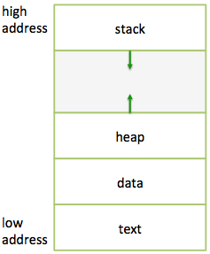
Process Context
When a program loaded into memory, it is organized into the following segments of memory
text contains the actual program code, or executable instructions
data contains global and static var-iables initialized at runtime
heap contains dynamic memory al-located at runtime
stack contains return addresses, func-tion parameters, and variables
This is known as User Level Context

Slide 11
User Level Context
…
int aa;
char buf[1000];
void foo() {
int a;
…
}
main() {
int b;
char *p;
p = new char[1000];
foo();
}
MAX
(b, *p) - main
(a) - foo
stack
heap (p)
(char[1000])
data (aa, buf)
text (code)
0

Slide 12
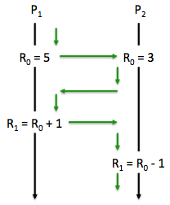
Process Context
Is the user level context sufficient?
Does it contain all the states necessary to run a program?
Only if the system runs through one program at a time
The OS typically needs to switch back and forth between programs – processes must be “swapped” in and out from getting to use the CPU
R₁ in P₁ is incorrect… why? How to make it right?
Save R₀ in P₁ before switching
Restore R₀ in P₁ when switching from P2 to P1
Registers should be a part of process context
This is called Register Context

Slide 13
Register Context
We need to save everything that we need to independently run a process
Program Counter (PC)
Address of next instruction to be executed (may be in kernel or user memory space of this process)
Processor Status Register
Contains the hardware status at the time of preemption – contents and format are hardware dependent
Stack Pointer (SP)
Points to the top of the kernel or user stack, depending on the mode of operation at the time of preemption
General-Purpose Registers
Hardware dependent, R₀, R₁, R₂, …

Slide 14
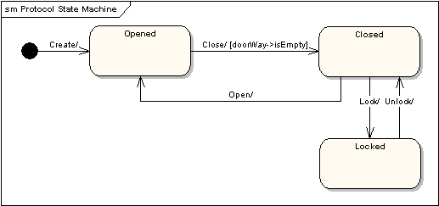
State Machine
A state machine diagram models the behaviour of a single object, specifying the sequence of events that an object goes through during its lifetime in response to events.
For e.g. the following state machine diagram shows the states that a door goes through during its lifetime.

Slide 15
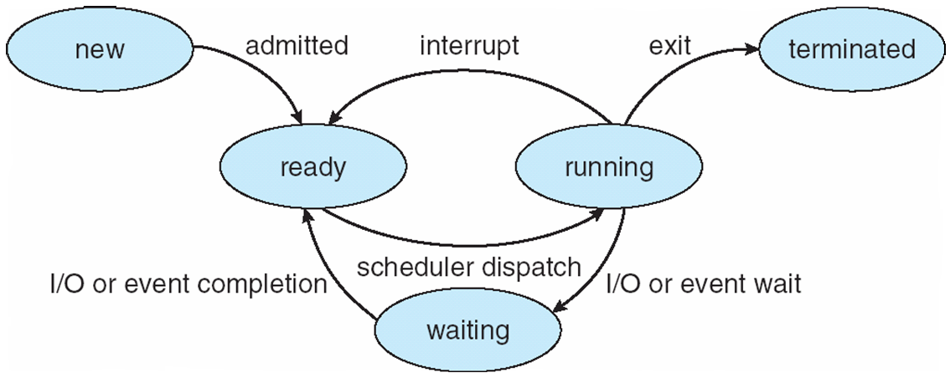
Process State
A process executes according to the following state machine:
created also “new”, initial state when created
waiting also “ready”, awaiting to be scheduled for execution
running actively executing instructions on the CPU
blocked unable to continue without event occurring, e.g., I/O
terminated no longer running due to completion or being killed
created / new
terminated
waiting / ready
running
blocked

Slide 16
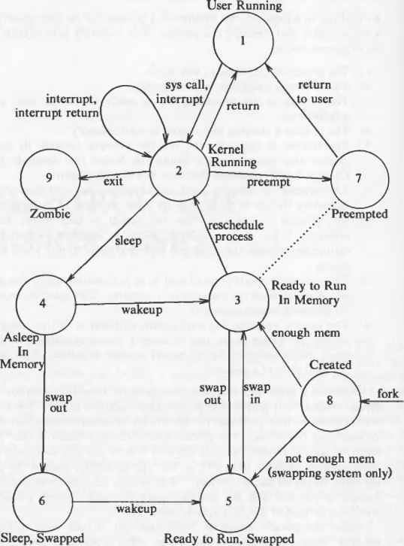
A more detailed state diagram
1. The process is executing in user mode.
2. The process is executing in kernel mode.
3. The process is not executing but is ready to run as soon as the kernel schedules it.
4. The process is sleeping and resides ¡n main memory.
5. The process is ready to run, but the swapper (process 0) must swap the process into main memory before the kernel can schedule it to execute.
6. The process is sleeping, and the swapper has swapped the process to secondary storage to make room for other processes in main memory.
7. The process is returning from the kernel to user mode, but the kernel preempts it and does a context switch to schedule another process. The distinction between this state and state 3 ("ready to run") will be brought out shortly.
8. The process is newly created and is in a transition state; the process exists, but it is not ready to run, nor is it sleeping. This state is the start state for all processes except process 0.
9. The process executed the exit system call and is in the zombie state. The process no longer exists, but it leaves a record containing an exit code and some timing statistics for its parent process to collect. The zombie state is the final state of a process.
Notes:
https://www.beyonddiscovery.org/unix-operating-system/61-process-states-and-transitions.html

Slide 17
Process Context
User level context
Code, data, stack, heap
Register context
R0, R1, …, PC, SP, etc.
What else is needed?
(System-level context)
OS resources
Open files, signal related data structures, etc.
While a program is executing, the process can be uniquely identified by a number of elements, including:
Identifier (PID)
State
Priority
Program counter
Memory pointers
Context data
I/O status information
Accounting information
To run a process correctly, the process instructions must be executed within the process context!

Slide 18
Process Context
Formally, the context of a process is the union of its user-level context, register context, and system-level context
Where is the process context stored?
User level context is stored in memory
Other context information is stored in a data structure called process control block (PCB)
Contains other information that the OS needs to manage the process
Process status (running, waiting, etc.)
Process priority
…
The OS has a process control block table
For each process, there is one entry in the table

Slide 19
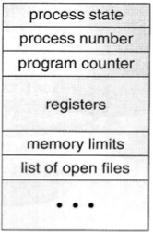
Process Control Block (PCB)
Information associated with each process (also called task control block)
Process state
Running, waiting, etc.
Program counter
Location of instruction to execute next
CPU registers
Contents of all process-centric registers
CPU scheduling information
Priorities, scheduling queue pointers
Memory-management information
Memory allocated to the process
Accounting information
CPU used, clock time elapsed since start, time limits
I/O status information
I/O devices allocated to process, list of open files

Slide 20
Context Switch

Slide 21
Process Scheduling
CPU Scheduler (short-term scheduler)
Selects which processes should be executed next and allocates the CPU
Invoked very frequently (milliseconds)
Processes can be described as either
I/O-bound
Spends more time doing I/O than computations; many short CPU bursts
CPU-bound
Spends more time doing computations; few very long CPU bursts

Slide 22
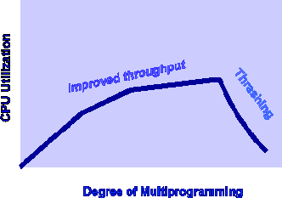
Process Scheduling
Job Scheduler (long-term scheduler)
Selects which processes to be brought into ready queue
Invoked very infrequently (seconds, minutes)
Controls degree of multiprogramming, the max number of processes accommodate efficiently
Maintains scheduling queues of processes
Job queue
Set of all PCBs in the system
Ready queue
Set of all processes residing in main memory, ready and waiting to execute
Device queues
Set of processes waiting for an I/O device
Processes migrate among the various queues

Slide 23
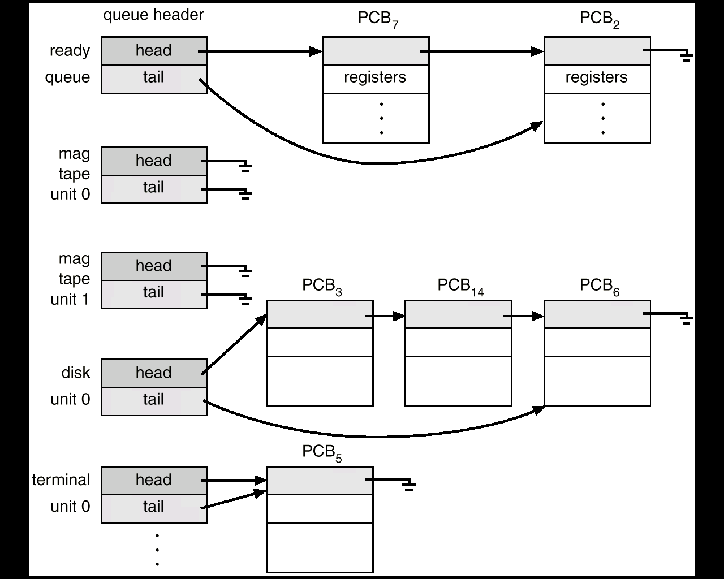
Ready Queue and I/O Device Queues

Slide 24
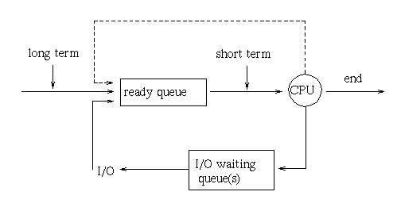
Long- and Short-Term Schedulers
Ready queue
Set of all processes residing in main memory, ready and waiting to execute
Long-term scheduler
Selects which processes to be brought into ready queue
CPU Scheduler (short-term scheduler)
Selects which processes should be executed next and allocates the CPU
Device or I/O waiting queues
Set of processes waiting for an I/O device

Slide 25
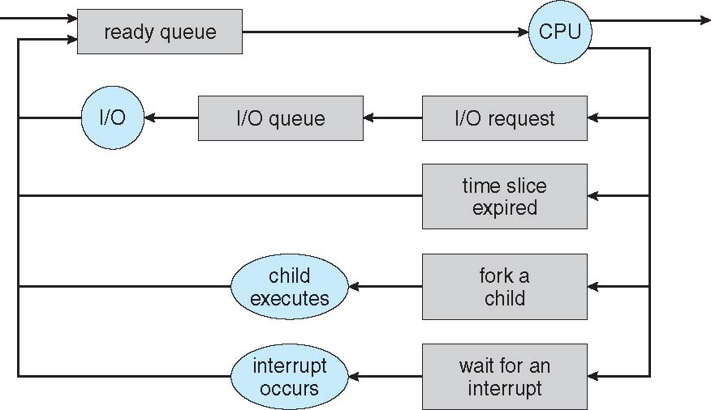
Process Scheduling Representation
Queueing diagram represents queues, resource flows

Slide 26
Context Switch
When CPU switches to another process, the OS must
Save the PCB of old process being swapped out
Select new process to be swapped in
Load the PCB of the new process being swapped in
Context-switch time is overhead
The system does no useful work while switching
Typical time about 1 μsec
The more complex the OS and the PCB, the longer the context switch
Time dependent on hardware support
Some hardware provides multiple sets of registers per CPU, resulting in multiple contexts loaded at once E.g. The Sun UltraSPARC processor hardware (developed by Sun Microsystems) has multiple register sets. So, context switch simply requires that the CPU current-register-set pointer is changed to the register set containing the new context, which takes very little time.

Slide 27
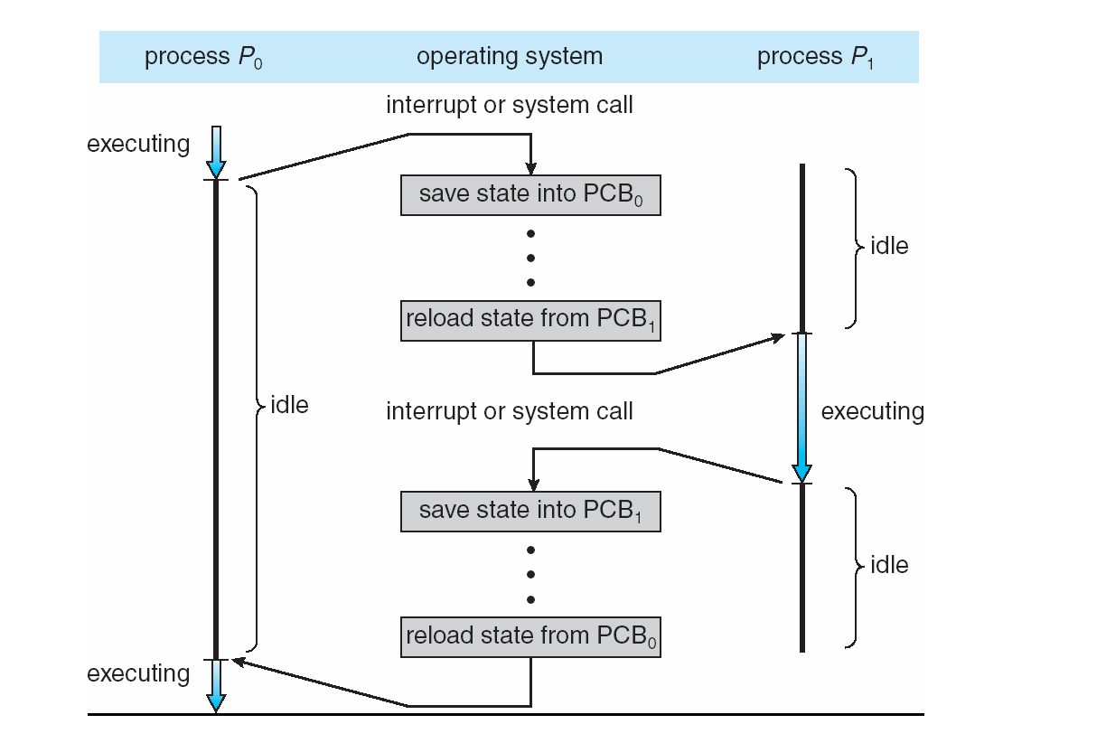
Context Switch

Slide 28
Process Execution

Slide 29
The exec() System Call
Calling one of the exec() family of system calls
Terminates the currently running program, and
Replaces it with a new specified program that starts executing in its main() function
The process ID does not change across an exec because a new process is not created
exec() merely replaces the current process (its text, data, heap, and stack segments) with a brand new program from disk

Slide 30
The exec() Family
There are 6 versions of the exec function, and they all do about the same thing:
Main difference is how parameters are passed
#include <unistd.h>
int execlp(char *file, char *arg0, char *arg1, ..., (char *)0);
execlp("sort", "sort", "-n", "city", (char *)0);
Same as "sort -n city"

Slide 31
The exec() Family
int execl(const char *path, const char *arg, ... );
execl takes full path name of command and variable length of arguments terminated by NULL
execl("/bin/ls", "/bin/ls", "-r", "-t", "-l", NULL);
int execlp(const char *file, const char *arg, ... );
execlp will try to find the command from $PATH, so full path to command not needed
execlp("ls", "ls", "-r", "-t", "-l", NULL);
int execle(const char *path, const char *arg, ..., char *const envp[] );
execle uses an argument list and environment variables
char *env[] = {"PATH=/bin", NULL};
execle("child.exe", "child", "arg1", "arg2", NULL, env);

Slide 32
The exec() Family
int execv(const char *path, char *const argv[]);
execv is the equivalent of execl, except that the arguments are passed in as a NULL terminated array
char *args[] = {"/bin/ls", "-r", "-t", "-l", NULL};
execv("/bin/ls", args);
int execvp(const char *file, char *const argv[]);
execvp is the equivalent of execlp, except that the arguments are passed in as a NULL terminated array
char *args[] = {"ls", "-r", "-t", "-l", NULL};
execvp("ls", args);
int execve(const char *filename, char *const
argv [], char *const envp[] );

Slide 33
The exec() Family
All six return –1 on error, but no return on success
Accept either a pathname or filename argument
Command-line arguments are specified as separate arguments or we have to build an array of pointers to the arguments and pass the address of the array

Slide 34
execlp Example
execlp.c
#include <stdio.h>
#include <unistd.h>
int main()
{
char *cmd[] = {"who", "ls", "date"};
int i;
printf("0=who 1=ls 2=date : ");
scanf("%d", &i);
execlp(cmd[i], cmd[i], (char *)0 );
printf("execlp failed\n");
return 0;
}
tinymenu
cmd[i]
execlp()
printf() not executed unless there is a problem with execlp()

Slide 35
Process Creation

Slide 36
Process Creation
A parent process creates child processes, which create other processes, forming a tree of processes
Generally, processes identified and managed via a process identifier (PID)
Execution options
Parent and children execute concurrently
Parent waits until children terminate

Slide 37
The fork() System Call
Creation of a new process accomplished using the fork() system call
fork() creates a child process by making an exact copy of the parent process and then starts the process concurrently
fork() system call is unique
Called once, but returns twice with the parent receiving the child’s unique PID and the child receiving 0 as the return value from fork()
The process that initiates the fork() becomes the parent process of the newly created child process
The child process inherits a copy of the parent’s memory space, but they do not share the same memory as both parent and child processes will execute in their own environments

Slide 38
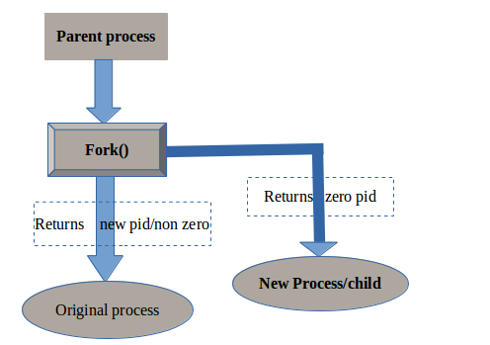
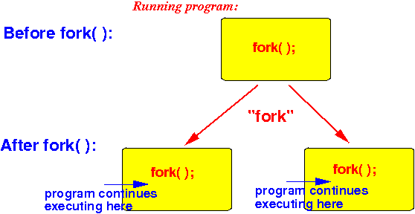
The fork() System Call
Current process splits into two processes: parent, child
Returns -1 if unsuccessful
Returns 0 in the child
Returns the child’s PID in the parent
Execution continues in both processes

Slide 39
Why we use fork()
There are two uses for fork:
When a process wants to duplicate itself so that the parent and child can each execute different sections of code at the same time
This is common for network servers
– the parent waits for a service request from a client
– when the request arrives, the parent calls fork() and lets the child handle the request
– parent goes back to waiting for the next service request to arrive
When a process wants to execute a different program
This is common for shells
In this case, the child typically does an exec() right after it returns from the fork

Slide 40

Why does fork() fail
The two main reasons for fork to fail are
If there are already too many processes in the system (which usually means something else is wrong)
If the total number of processes for this real user ID exceeds the system’s limit cat /proc/sys/kernel/pid_max --- > Max unique PIDs the system supports

Slide 41
fork() Example
#include <stdio.h>
#include <sys/types.h>
#include <unistd.h>
int main()
{
pid_t pid; /* could be int */
int i;
pid = fork();
printf("PID=%d\n", pid);
if( pid > 0 )
{
/* parent */
for( i=0; i < 10; i++ )
printf("\t\t\tPARENT %d\n", i);
}
else
{
/* child */
for( i=0; i < 10; i++ )
printf("CHILD %d\n", i );
}
return 0;
}

Slide 42
fork() Example
Notes for code on previous slide
i is copied between parent and child
The switching between the parent and child depends on many factors:
Machine load, system process scheduling
I/O buffering affects amount of output shown
Output interleaving is nondeterministic
Cannot determine exact output by looking at code

Slide 43
Process Synchronization

Slide 44
Why Process synchronization must be implemented?
To prevent data inconsistency among processes
To prevent process deadlocks
To prevent race conditions (i.e. when two or more operations are executed at the same time)
When you start a program
it is loaded and given an address space in main memory from your hard disk
Next, it is scheduled onto an available CPU
Next, the process instructions are executed simultaneously
CPU will execute each line of a program sequentially and keep track which instruction is going to execute next by means of a ________________ (Hint: it’s a register)

Slide 45
wait() and waitpid() System Calls
The wait() and waitpid() system calls force the parent process to suspend execution until the child process has completed
Process suspension : Whenever the processes in main memory are entered into the blocked state, the OS suspends one process by putting it in the Suspended state and transferring it to disk. The free space present in the memory is used for bringing another process.
waitpid() waits for a specific child process identified by its PID while wait() simply waits for the first child process to terminate (if the parent has more than one child process)
Both return the PID of the terminated process if successful
Or –1 if an error occurred (usually means no child exists to wait on)
Once the child process has terminated, the parent process resumes execution

Slide 46
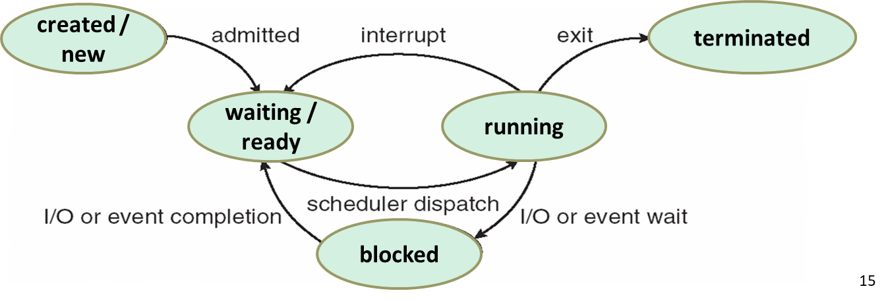
Purpose of process suspension
Swapping
Timing
Interactive User request
Parent process request
Processes are typically in Ready, Running, Blocked states.
But there is also a suspended state.
If any process which is in the Ready state does not occupy the main memory, OS swaps one of the blocked processes out into the Suspend queue.
When a Suspended process is ready to run it moves into Ready, Suspend queue. Thus, we have two more states which are Blocked_Suspend and Ready_Suspend.

Slide 47
wait() Function
#include <sys/types.h> #include <sys/wait.h> pid_t wait(int *statloc);
statloc argument can have two values: 1.NULL pointer i.e. (int *)0 or 2.pointer to an integer i.e. a variable which will be bound to status information about the child
A process that calls wait() can
suspend (block) if all of its children are still running
return immediately with the termination status of a child
return immediately with an error if there are no child processes.

Slide 48
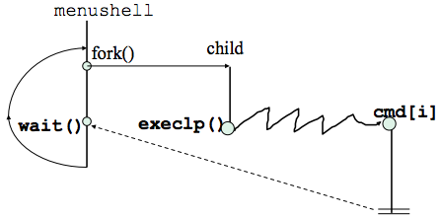
wait() Example
#include <stdio.h>
#include <stdlib.h>
#include <unistd.h>
#include <sys/types.h>
#include <sys/wait.h>
int main() {
char *cmd[] = {"who", "ls", "date"};
int i;
while( 1 ) {
printf("0=who 1=ls 2=date : ");
scanf("%d", &i);
if(fork() == 0) {
/* child */
execlp( cmd[i], cmd[i], (char *)0 );
printf("execlp failed\n");
exit(1);
}
else {
/* parent */
wait( (int *)0 );
printf("child finished\n");
}
} /* while */
} /* main */

Slide 49
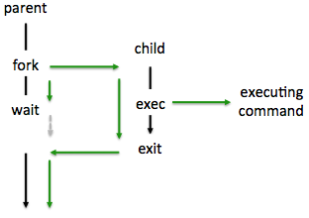
The fork-exec Model
Common use of the fork() and exec() system calls centers around being able to run another program in parallel without terminating the current process
Parent process uses fork() to create the child process, which will then use the exec() family of system calls to run the desired program while the parent waits on the child to terminate

Slide 50
Process Termination

Slide 51
Process Termination
A process may be terminated
When it executes its last statement and asks the operating system to delete it
By calling the exit() system call in the <stdlib.h> library
A parent may terminate execution of child processes using the abort() system call if
Child has exceeded allocated resources
Task assigned to child is no longer required
Parent is exiting
Some operating systems do not allow child to continue if its parent terminates
When a child process terminates, a SIGCHLD signal is sent to the parent

Slide 52
Zombies and Orphans
A child process whose parent has terminated is referred to as an orphan
Child is still executing, but parent has terminated
Some process is needed to query the child’s exit status
When a child exits and its parent is not currently waiting (i.e., executing a wait()), it becomes a zombie
A zombie is not really a process (since it terminated), but the system still has an entry in the process table for the non-existing child process
When a parent terminates, any orphans and zombies are adopted by the init process (PID 1) of the system

Slide 53
Process Identification

Slide 54
Process Groups
What happens when you Ctrl-C a program that created several children?
Typically the program and its children terminate
Why the children? (part of the signal handler definition)
In addition to having a unique ID, a process also belongs to a process group
Several processes can be members of the same process group
When a process forks, the child inherits its process group from its parent
A process can change its process group to a new value by using setpgid()
When a process execs, its process group remains the same
A process group is used to control the distribution of a signal; when a signal is directed to a process group, the signal is delivered to each process that is a member of that process group

Slide 55
Process Groups
A “process group” is a logical cluster of processes that belong to the same application or deployment unit and perform the same function across multiple hosts.
The distribution of signals to process groups forms the basis of job control employed by shell programs.
Process groups are key building blocks of most modern web-based applications.
A session denotes a collection of one or more process groups.

Slide 56
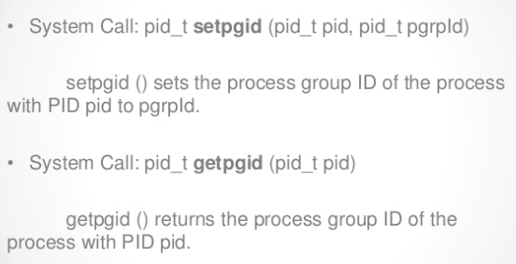
Process Identification
pid = getpid( );
Returns its own process id
pid = getppid( );
Returns parent process id
uid = getuid( );
Returns real user ID of own process
newpg = setpgrp( );
Sets process group of own process to itself
pgid = getpgrp( );
Returns the process group ID of own process

Slide 57
Process and Group ID’s Example
#include <stdio.h>
#include <sys/types.h>
#include <stdlib.h>
//#include <unistd.h>
int main() {
pid_t cpid, pid, pgid, cpgid; //process id's and process groups
cpid = fork();
if (cpid == 0) {
/* CHILD */
//set process group to itself
setpgrp(); //<---------------------------!
//print the pid, and pgid of child from child
pid = getpid();
pgid = getpgrp();
printf("Child: pid:%d pgid:*%d*\n", pid, pgid);
}
else if (cpid > 0) {
/* PARENT */
//set the process group of child
setpgid(cpid, cpid); //<----needed to disambiguate runtime process
//print the pid, and pgid of parent
pid = getpid();
pgid = getpgrp();
printf("Parent: pid:%d pgid: %d \n", pid, pgid);
//print the pid, and pgid of child from parent
cpgid = getpgid(cpid);
printf("Parent: Child's pid:%d pgid:*%d*\n", cpid, cpgid);
}
else {
/*ERROR*/
perror("fork");
exit(1);
}
return 0;
}
With this, it will not matter which runs first, parent or child, as the result will be the same – the child placed in the appropriate process group

Slide 58
Process Data

Slide 59
Process Data
Since a child process is a copy of the parent, it has copies of the parent’s data
A change to a variable in the child will not change that variable in the parent

Slide 60
Process Data Example
processdataeg.c
#include <stdio.h>
#include <sys/types.h>
#include <unistd.h>
int glbvar = 6;
int main() {
int locvar = 88;
pid_t pid;
printf("Before fork()\n");
if( (pid = fork()) == 0 ) {
/* child */
glbvar++;
locvar++;
}
else if ( pid > 0 ) {
/* parent */
sleep(2);
}
else
perror("fork error");
printf("pid=%d, glbvar=%d, locvar=%d\n", getpid(), glbvar, locvar);
return 0;
} /* end main */

Slide 61
Inherited Data and File Descriptors
A forked child has instances of current values of the variables and open file descriptors
Variables
Passed by value (i.e., a copy)
Read/write pointers for a file
Passed by reference

Slide 62
Process File Descriptors
A child and parent have copies of the file descriptors, but the R-W pointer is maintained by the system
The R-W pointer is shared
This means that a read() or write() in one process will affect the other process since the R-W pointer is changed

Slide 63
Process File Descriptors Example
filedescriptoreg.c
#include <stdio.h>
#include <sys/types.h>
#include <sys/wait.h>
#include <unistd.h>
#include <fcntl.h>
void printpos(char *msg, int fd);
int main() {
int fd; /* file descriptor */
pid_t pid;
char buf[10]; /* for file data */
if ((fd=open("file1", O_RDONLY)) < 0)
perror("open");
read(fd, buf, 10); /* move R-W ptr */
printpos("Before fork", fd );
if( (pid = fork()) == 0 ) {
/* child */
printpos("Child before read", fd);
read(fd, buf, 10);
printpos("Child after read", fd);
}
else if( pid > 0 ) {
/* parent */
wait((int *)0);
printpos("Parent after wait", fd);
}
else
perror("fork");
}

Slide 64
Process File Descriptors Example
/* Print position in file */
void printpos(char *msg, int fd) {
long int pos;
if( (pos = lseek( fd, 0L, SEEK_CUR) ) < 0L )
perror("lseek");
printf("%s: %ld\n", msg, pos);
}
Lseek repositions the file offset of the open file description associated with the filedescriptor fd to the argument 0L according to the directive SEEK_CUR (with SEEK_CUR the file offset is set to its current location plus offset bytes)
Return value:
Upon successful completion, Lseek() returns the resulting offset location as measured In bytes from the beginning of the file.
$ ./a.out
Before fork: 10
Child before read: 10
Child after read: 20
Parent after wait: 20
what's happened?

Slide 65
Process Creation Example
#include <stddef.h>
#include <stdlib.h>
#include <unistd.h>
#include <sys/types.h>
#include <sys/wait.h>
/* Execute the command using this shell program. */
#define SHELL "/bin/sh"
int
my_system (const char *command)
{
int status;
pid_t pid;
pid = fork ();
if (pid == 0)
{
/* This is the child process. Execute the shell command. */
execl (SHELL, SHELL, "-c", command, NULL);
_exit (EXIT_FAILURE);
}
else if (pid < 0)
/* The fork failed. Report failure. */
status = -1;
else
/* This is the parent process. Wait for the child to complete. */
if (waitpid (pid, &status, 0) != pid)
status = -1;
return status;
}
Here is an example program showing how you might write a function similar to the built-in system. It executes its command argument using the equivalent of ‘sh -c command’.
https://man7.org/linux/man-pages/man3/system.3.html

Slide 66
Process Creation Example
There are a couple of things you should pay attention to in this example.
Remember that the first argv argument supplied to the program represents the name of the program being executed. That is why, in the call to execl, SHELL is supplied once to name the program to execute and a second time to supply a value for argv[0].
The execl call in the child process doesn’t return if it is successful. If it fails, you must do something to make the child process terminate. Just returning a bad status code with return would leave two processes running the original program. Instead, the right behavior is for the child process to report failure to its parent process.
Call _exit to accomplish this. The reason for using _exit instead of exit is to avoid flushing fully buffered streams such as stdout. The buffers of these streams probably contain data that was copied from the parent process by the fork, data that will be output eventually by the parent process. Calling exit in the child would output the data twice

Slide 67
Process Creation Example
The specific attributes of the child process that differ from the parent process are:
The child process has its own unique process ID.
The parent process ID of the child process is the process ID of its parent process.
The child process gets its own copies of the parent process’s open file descriptors. Subsequently changing attributes of the file descriptors in the parent process won’t affect the file descriptors in the child, and vice versa. However, the file position associated with each descriptor is shared by both processes.
The elapsed processor times for the child process are set to zero.

Slide 68
Process Identification
Each process is named by a process ID number, a value of type pid_t.
The lifetime of a process ends when the parent process of the corresponding process waits on the process ID after the process has terminated.
Process IDs can also denote process groups and sessions.
The processes belonging to a single command are called a process group. This is so that you can operate on all of them at once.
You can get the process ID of a process by calling getpid. The function getppid returns the process ID of the parent of the current process (this is also known as the parent process ID). Your program should include the header files unistd.h and sys/types.h to use these functions.

Slide 69
Process Identification
Data Type: pid_t
The pid_t data type is a signed integer type which is capable of representing a process ID. In the GNU C Library, this is an int.
Function: pid_t getpid (void)
The getpid function returns the process ID of the current process.
Function: pid_t getppid (void)
The getppid function returns the process ID of the parent of the current process.

Slide 70
Process Termination
When a process terminates for any reason—either because the program terminates, or as a result of a signal—the following things happen:
All open file descriptors in the process are closed. Note that I/O streams are not flushed automatically when the process terminates.
A process exit status is saved to be reported back to the parent process via wait or waitpid. If the program exited, this status includes as its low-order 8 bits the program exit status.
Any child processes of the process being terminated are assigned a new parent process. (On most systems, including GNU, this is the init process, with process ID 1.)
A SIGCHLD signal is sent to the parent process.
If termination of a process causes a process group to become orphaned, and any member of that process group is stopped, then a SIGHUP signal and a SIGCONT signal are sent to each process in the group.

